Slide 1
Linda Mobley
Children’s Lives Matter
Speaking Engagement:
Domestic Abuse
Notes:
Cover

Slide 2
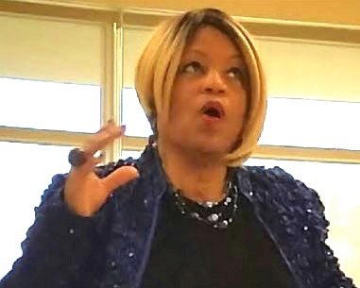
Oh no, he choked me!
Notes:
Image #1

Slide 3
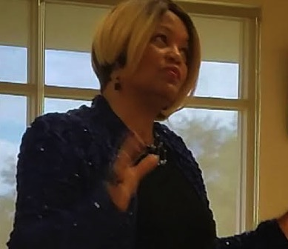
I couldn’t believe it!
Notes:
Image #2

Slide 4
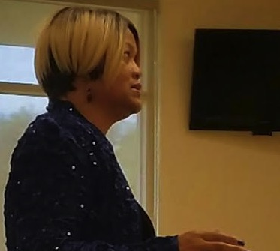
Oh my…what would you do?
Notes:
Image #3

Slide 5
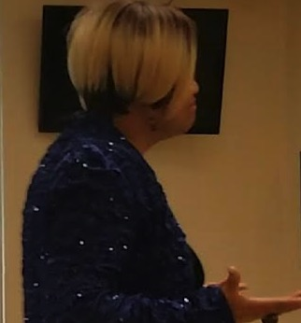
I cannot accept this
Notes:
Image #4

Slide 6
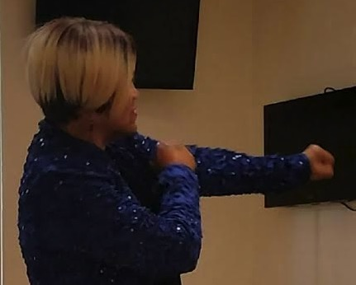
I’m going to need an epidural
Notes:
Image #5

Slide 7
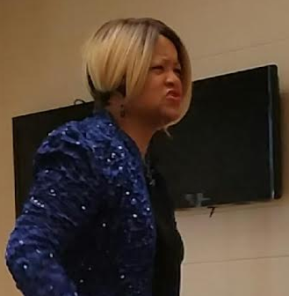
I was so scared!
Notes:
Image #6

Slide 8
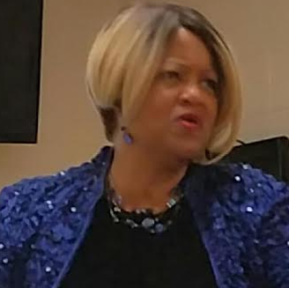
Oh my gosh…imagine that!
Notes:
Image #7

Slide 9
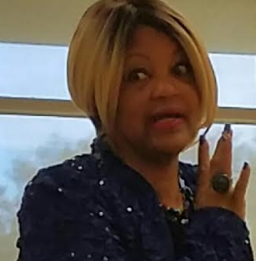
How can a baby come in 7 months?
Notes:
Image #8

Slide 10
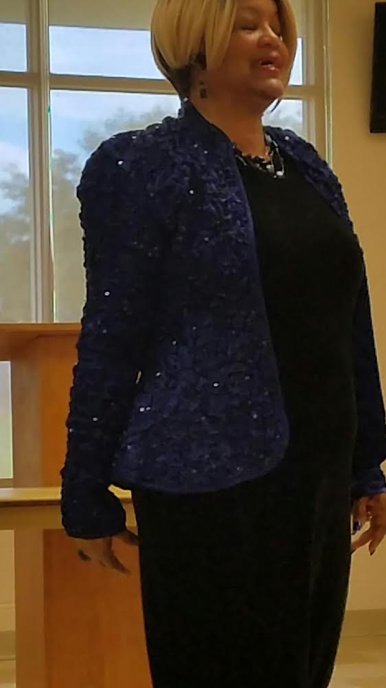
I was so afraid!
The baby had Jaundice
She had health problems
Notes:
Image #9

Slide 11
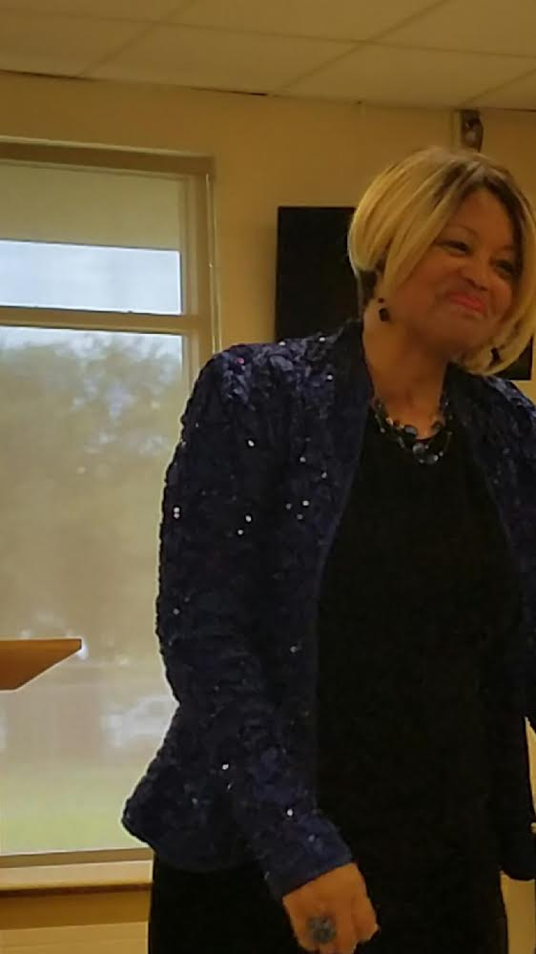
He passed out
You know men can’t take pain
You know what I mean?
Notes:
Image #10

Slide 12
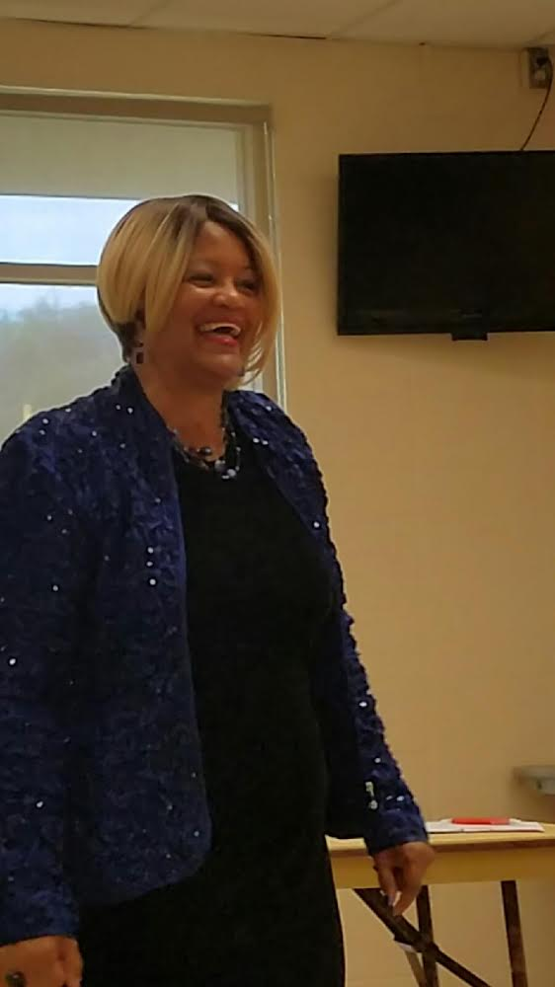
They can’t take it, but they can issue it
Notes:
Image #11

Slide 13
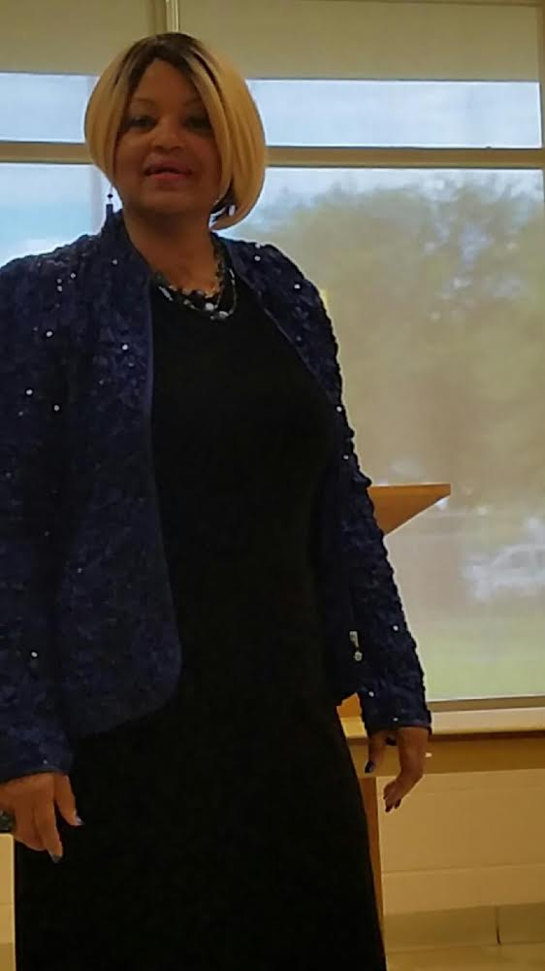
Wow, what some women go through!
Notes:
Image #13

Slide 14
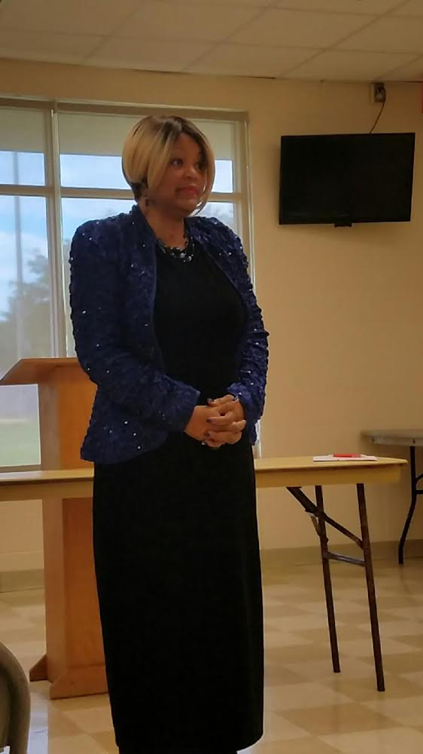
My baby and I went through a lot of:
emotions
pain
Notes:
Image #15

Slide 15
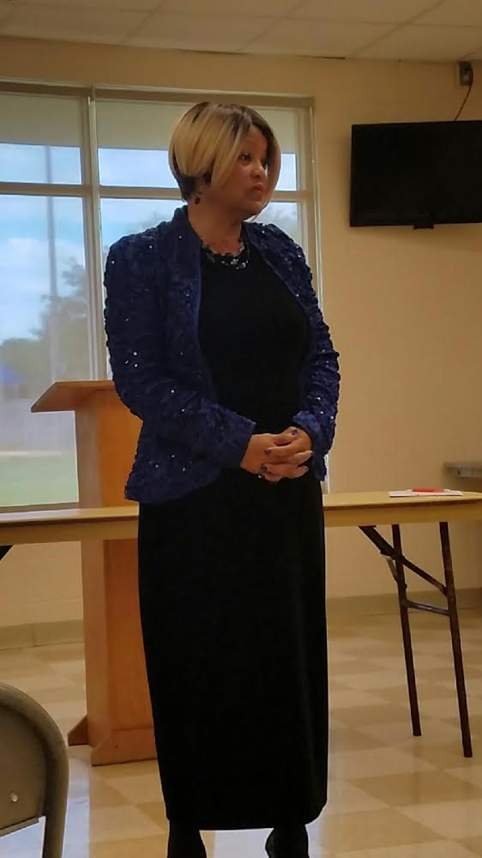
I don’t recommend this ladies
Notes:
Image #16

Slide 16
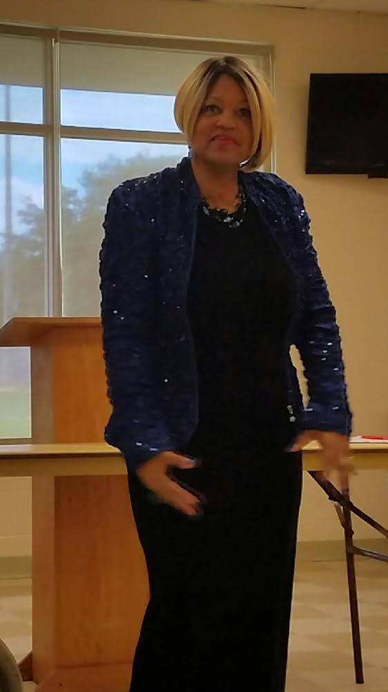
My baby was very difficult
She cried all of the time
Notes:
Image #17

Slide 17
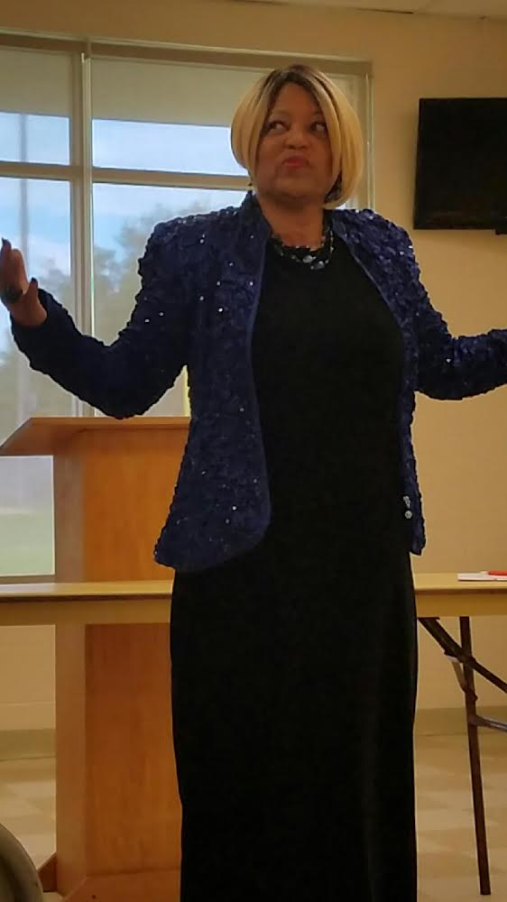
I learned later that my trauma
affected the baby
I learned a lot the hard way
I want to share what I learned
so others won’t suffer
Notes:
Image #18

Slide 18
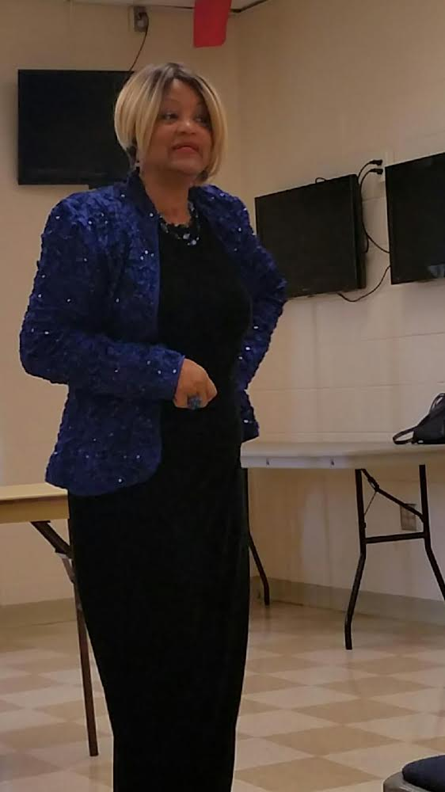
I wish I had known better
Ladies, don’t damage your baby
Notes:
Image #21

Slide 19
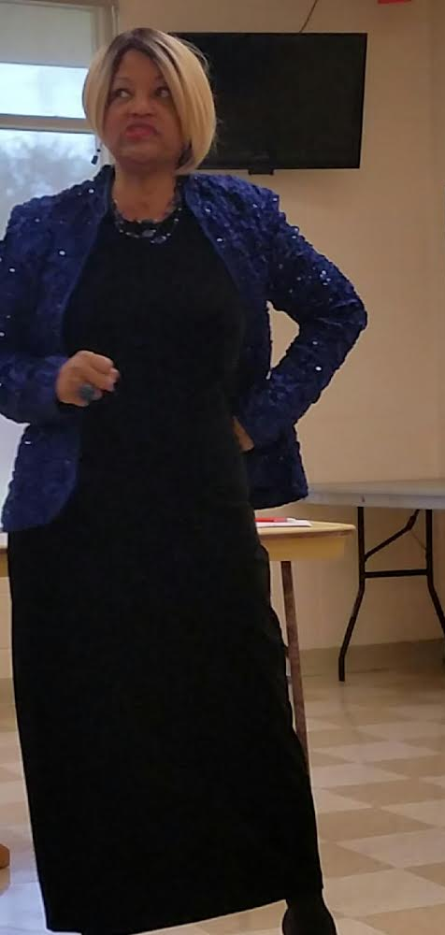
My husband never had compassion
What a disappointment
Notes:
Image #22

Slide 20
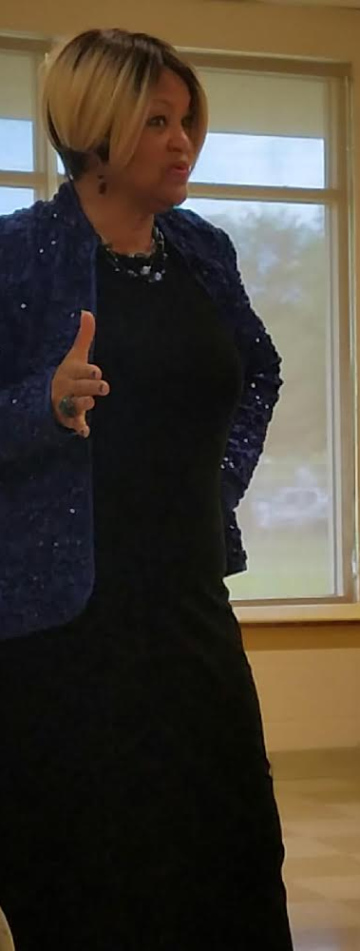
Ladies, never let a man choke you
Never let a man hit you
You will regret it
Notes:
Image #23

Slide 21
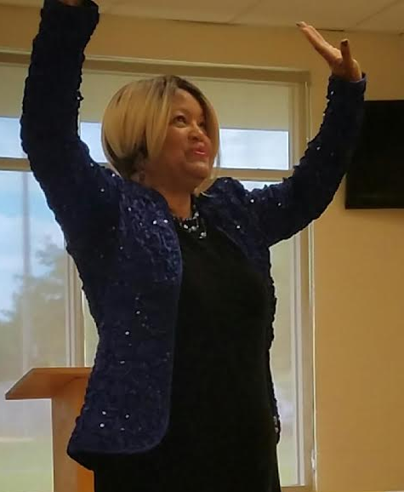
HALLELUJAH…!
I finally left the abuse
Notes:
Image #24

Slide 22
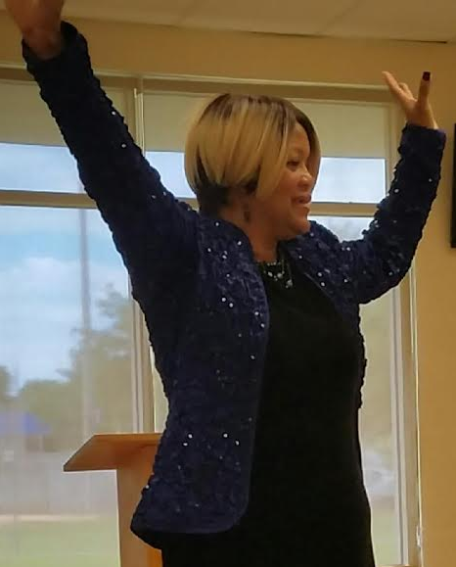
I’m free
I’m happy
No more tears
No more pain
Notes:
Image #25

Slide 23
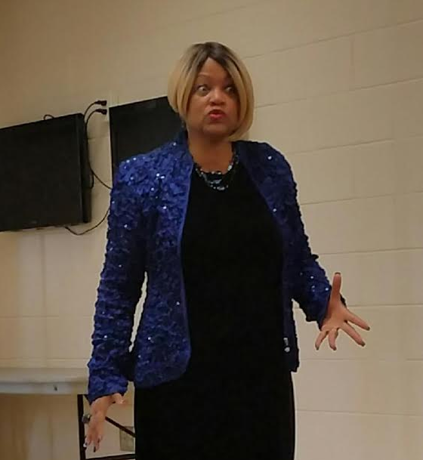
Why did I stay so long?
What was I thinking?
Notes:
Image #29

Slide 24
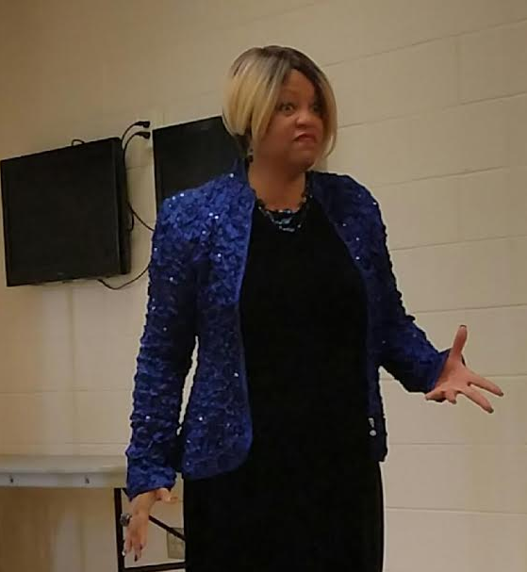
FINALLY…!
Notes:
Image #30

Slide 25
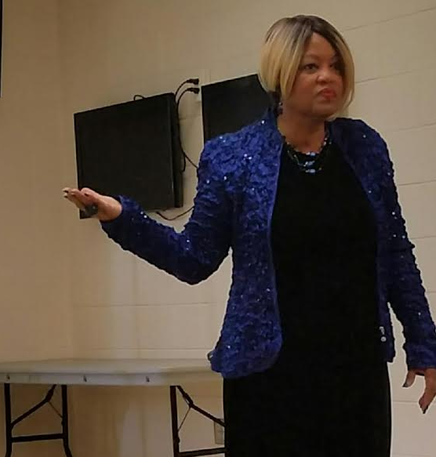
I made the decision to leave
Notes:
Image #32

Slide 26

To order a copy of this book, visit my website @
Childrenslivesmatter.net
Notes:
Image #32

